Slide 1
Fake News: An Adversarial Training Approach
By Christopher Barroso and Natalia Valencia

Slide 2
Overview
Introduction
Motivation
Pipeline Overview
Data
Preprocessing
Results
Discussion
Conclusion

Slide 3
Introduction and Motivation
What is fake news and why is it bad?
What is fake news classification/detection?
Our approach to training fake news classification models
All ML and DL models are vulnerable to adversarial attacks
Language models are no exception
How to make models more robust to adversarial attacks?
Adversarial training – training data contains perturbations

Slide 4
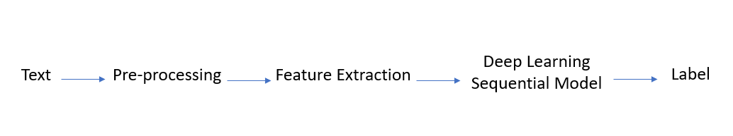
Pipeline Overview

Slide 5
Data
The GonzaloA / Fake_News_TFG Dataset repository is an English-language dataset containing over 45k unique news articles. The articles are classified either as real (1) or fake (0)
The dataset is composed of 40587 fields about news
The source data has a mix of different fake news datasets taken from Kaggle

Slide 6
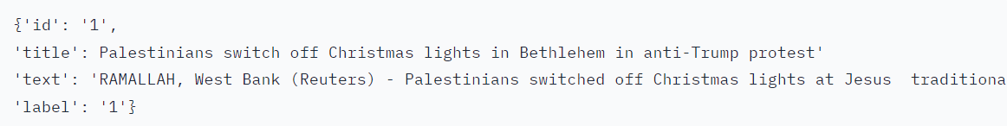
Data Fields
id: an integer value to count the rows in the dataset
title: a string that summarize the article
text: a string that contains the article
label: a boolean value that marks whether the article is real or fake

Slide 7
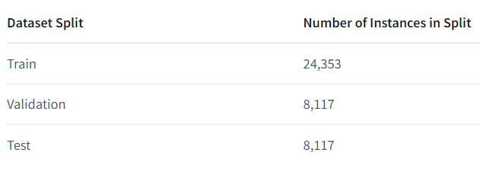
Data Splits

Slide 8
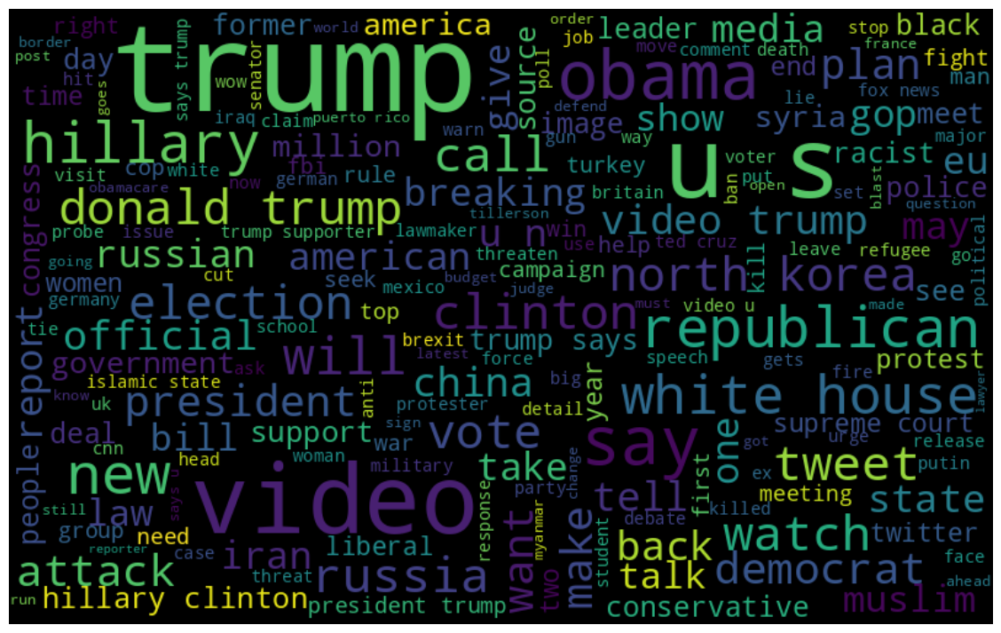
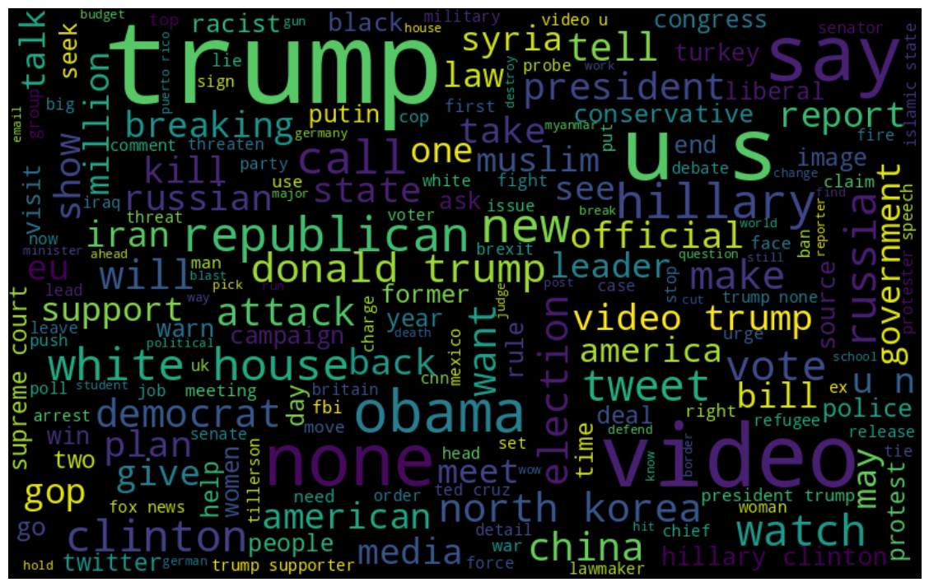
Summary View of Data
Training Dataset Wordcloud vs Negated Training Dataset Wordcloud

Slide 9
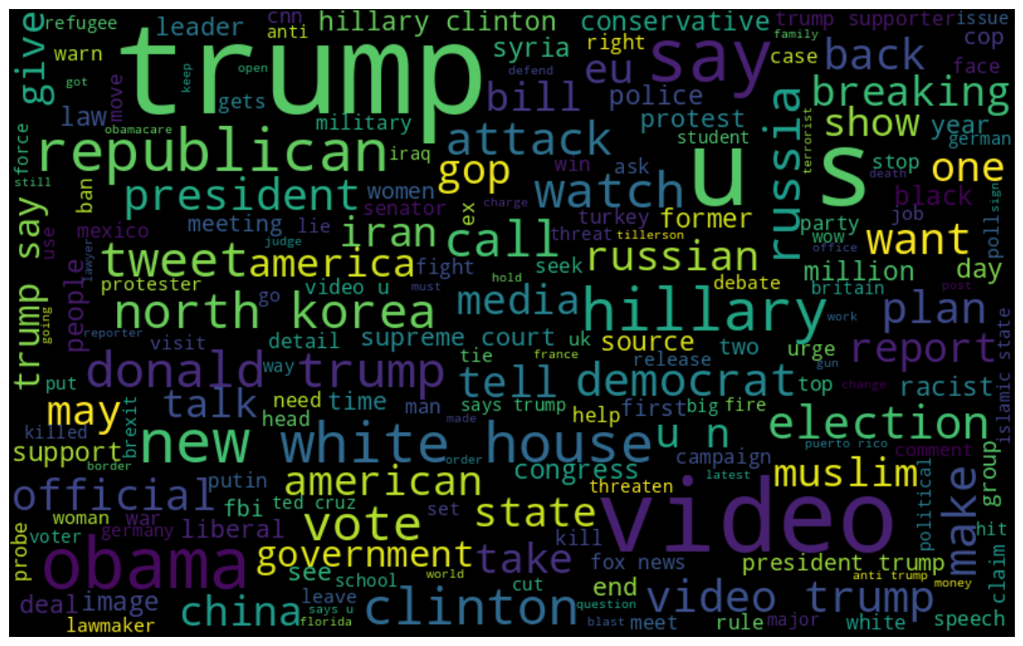
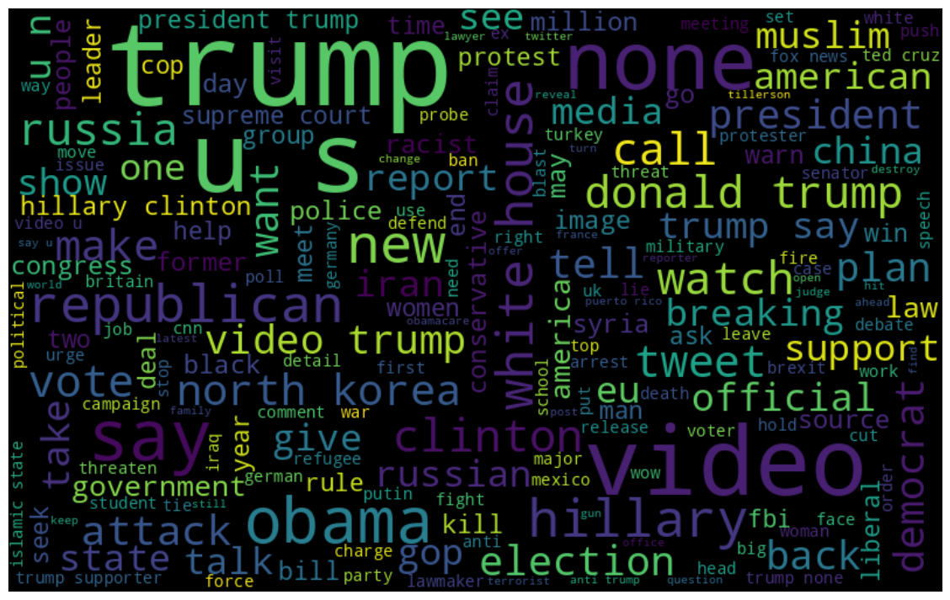
Summary View of Data
Training Dataset Wordcloud no stopwords vs Negated Training Dataset Wordcloud no stopwords

Slide 10
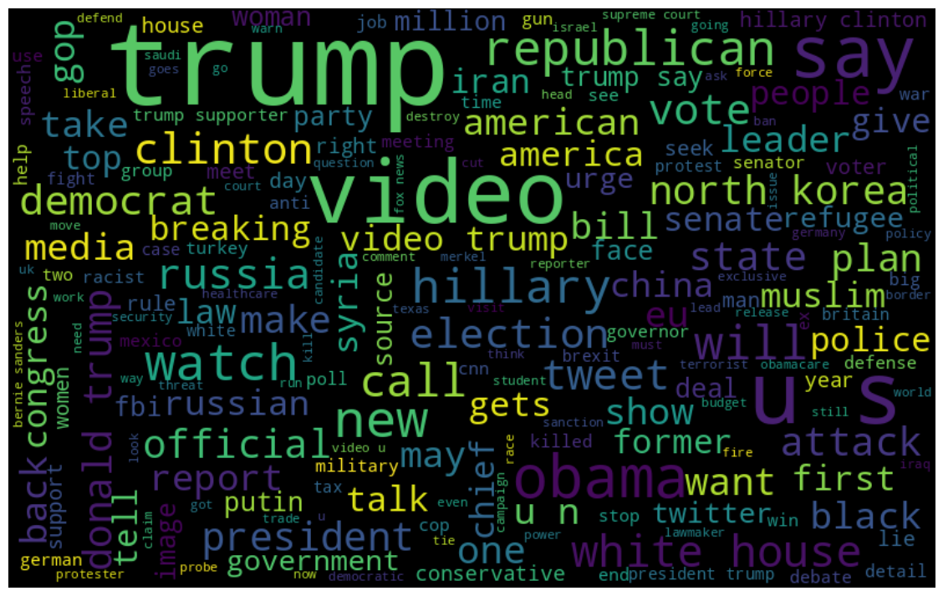
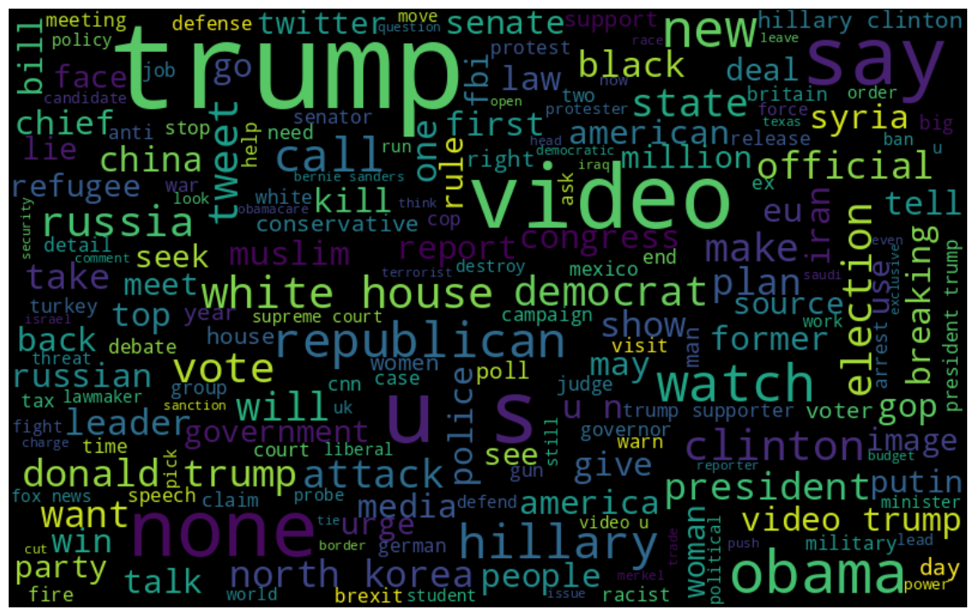
Summary View of Data
Validation Dataset Wordcloud vs Negated Validation Dataset Wordcloud

Slide 11
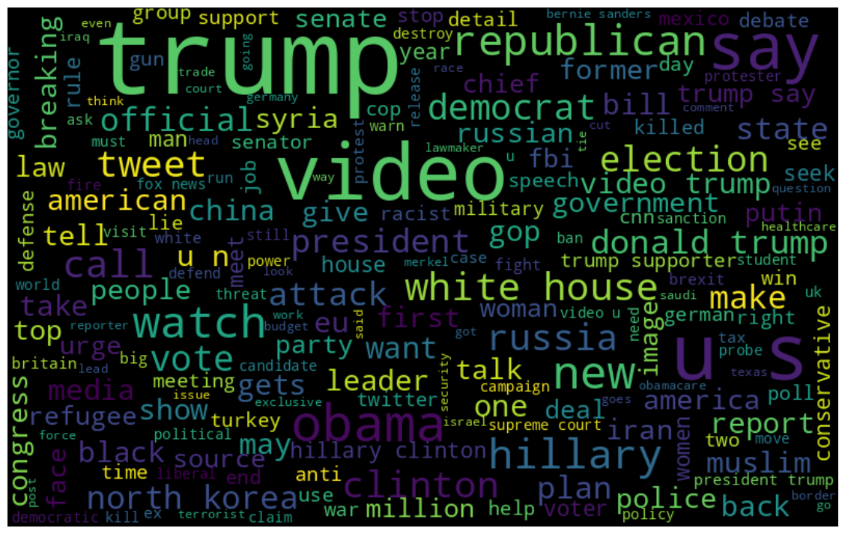
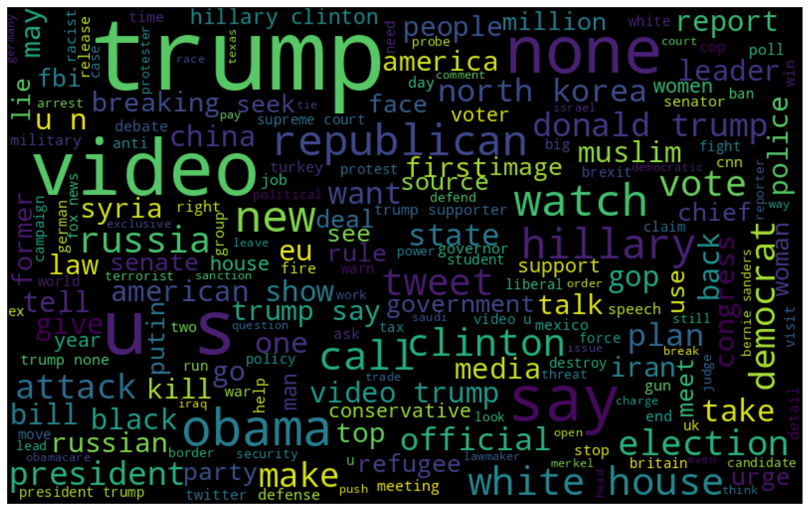
Summary View of Data
Validation Dataset Wordcloud no stopwords vs Negated Validation Dataset Wordcloud no stopwords

Slide 12
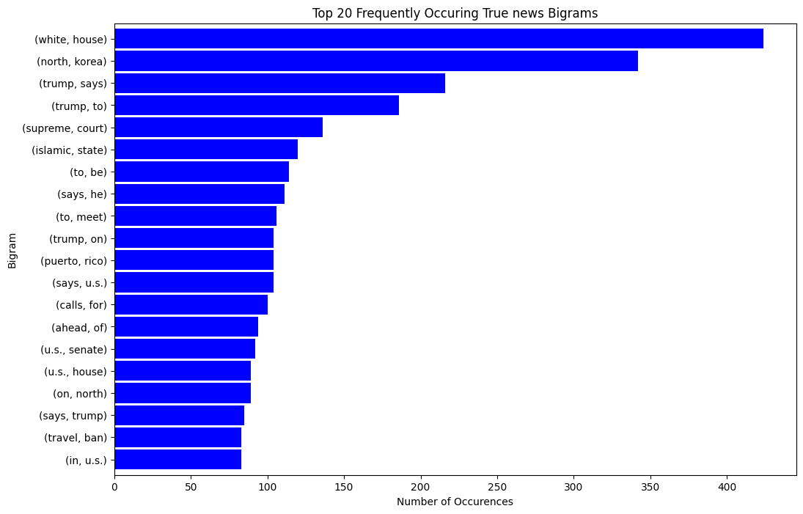
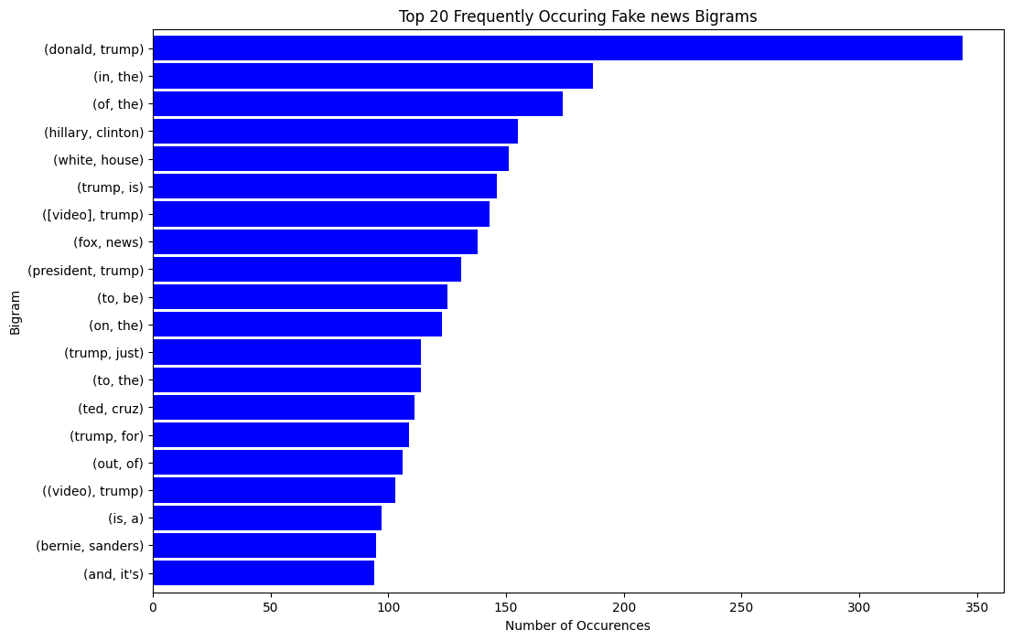
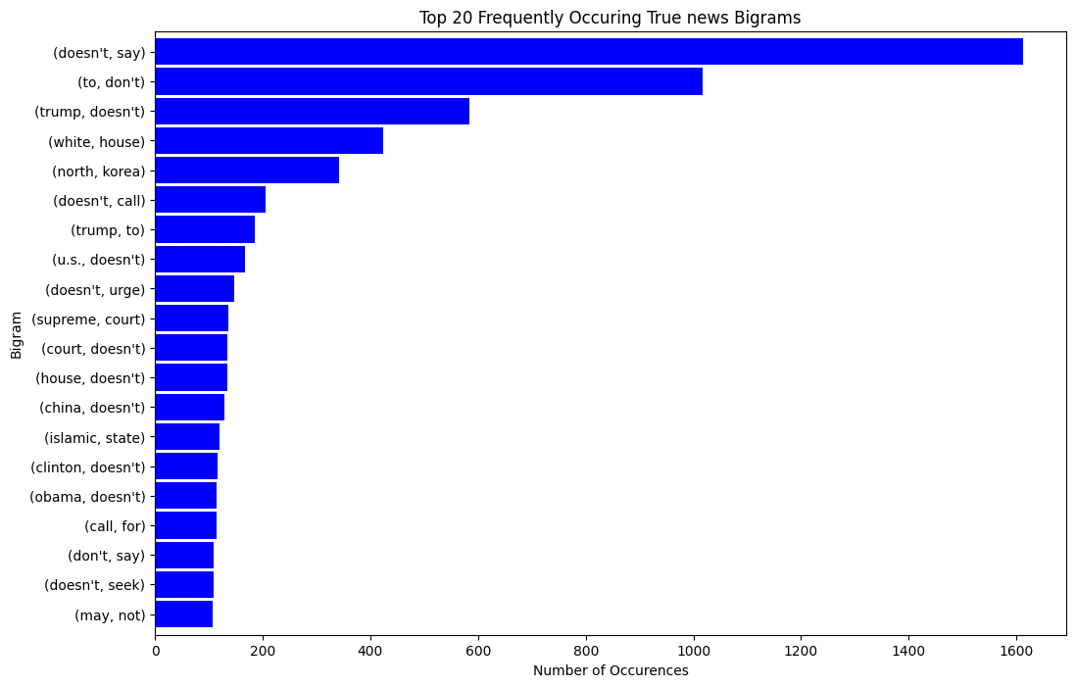
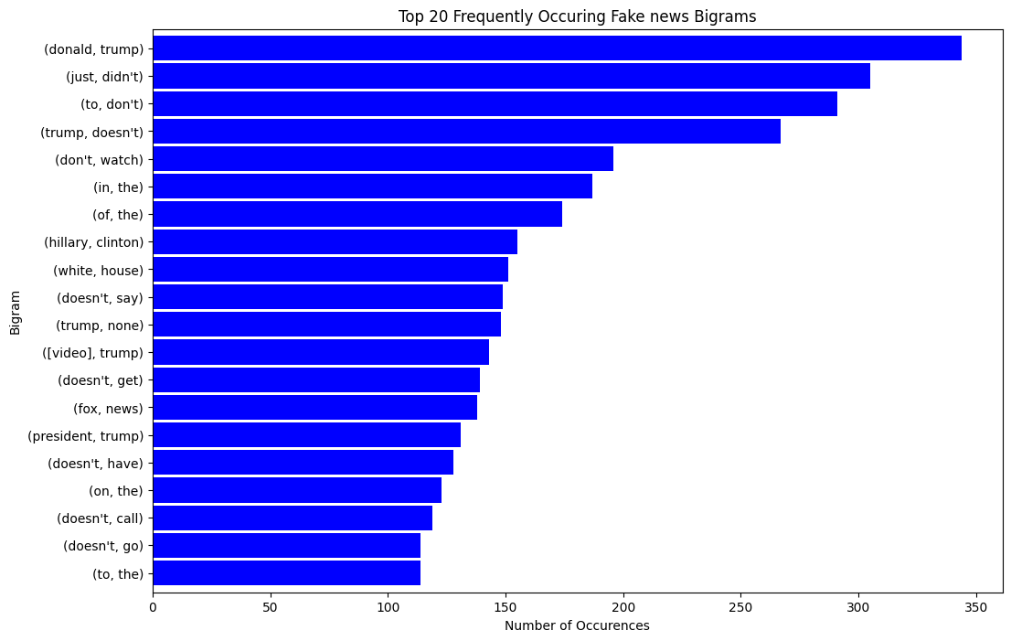
Summary View of Data
Training Dataset Bigrams vs Negated Training Dataset Bigrams

Slide 13
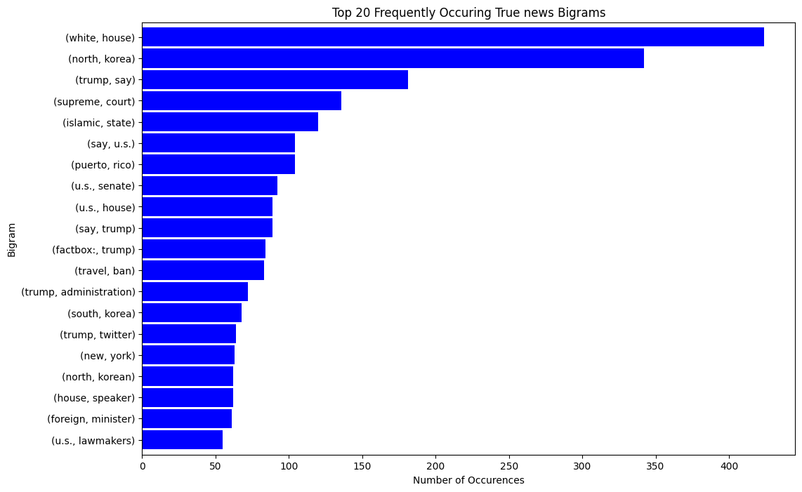
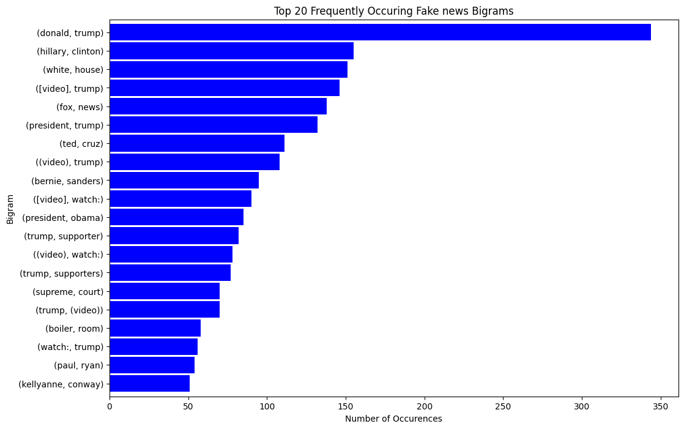
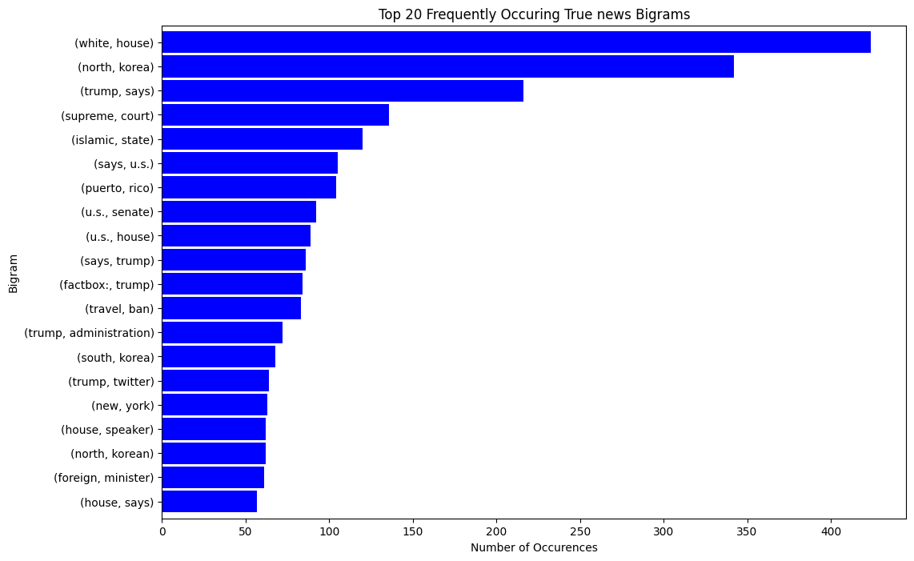
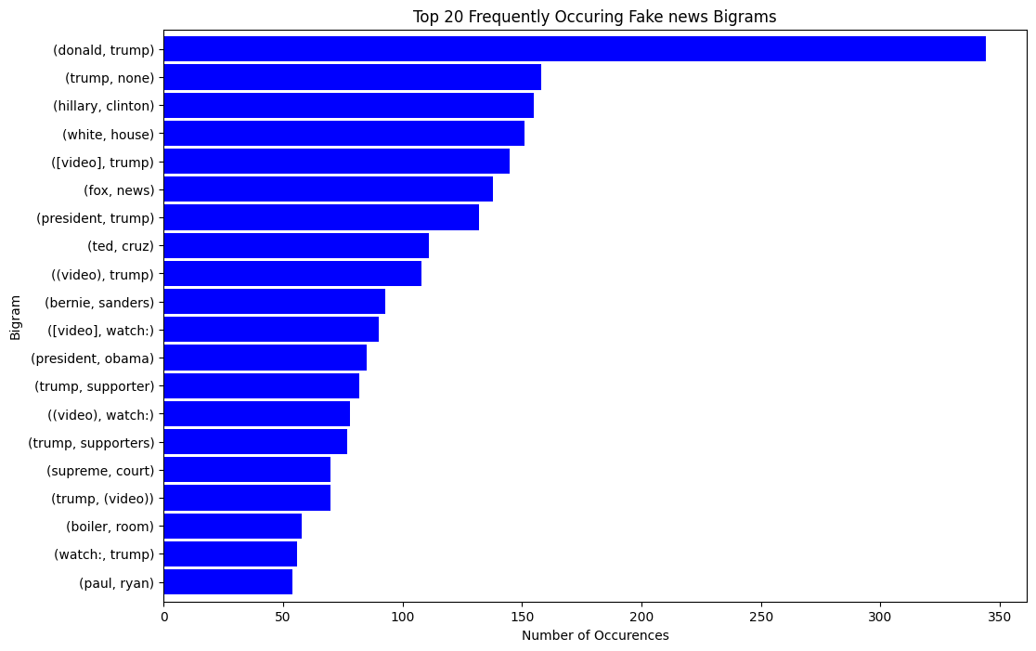
Summary View of Data
Training Dataset Bigrams no stopwords vs Negated Training Dataset Bigrams no stopwords

Slide 14
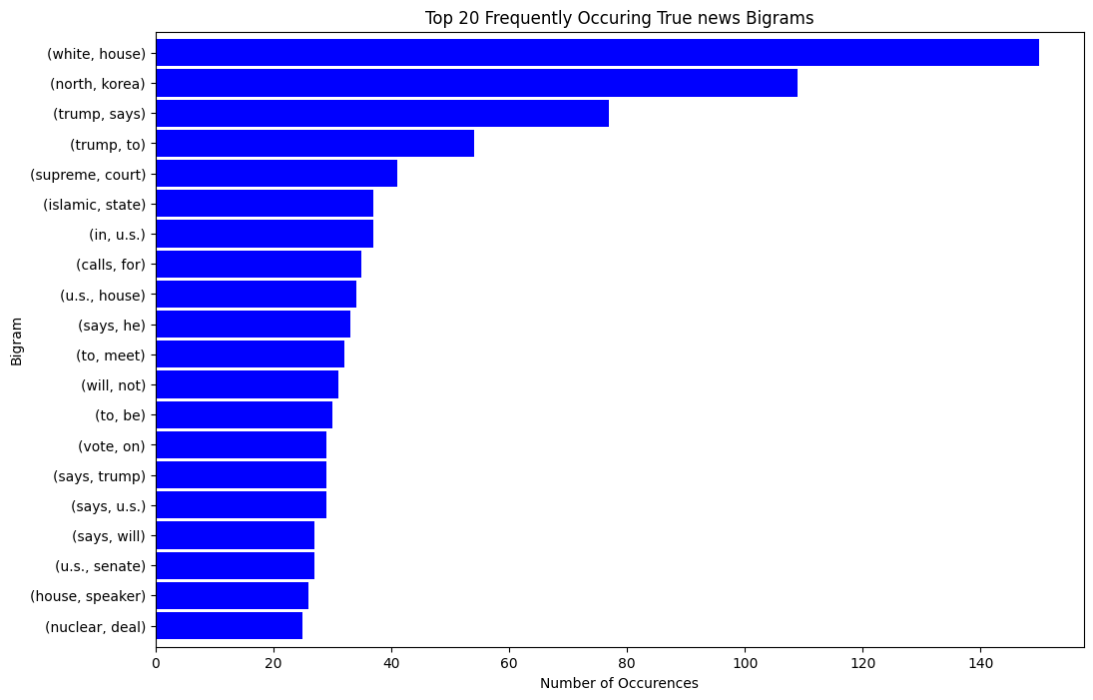
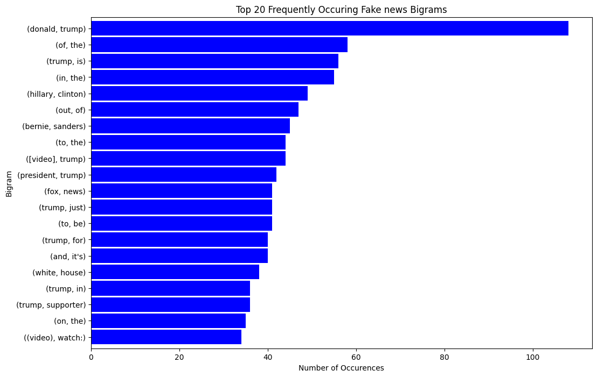
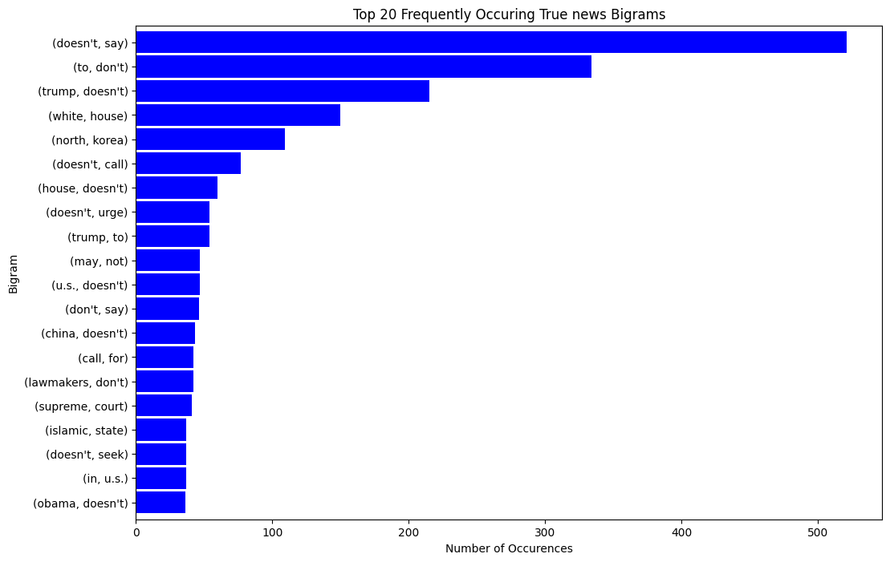
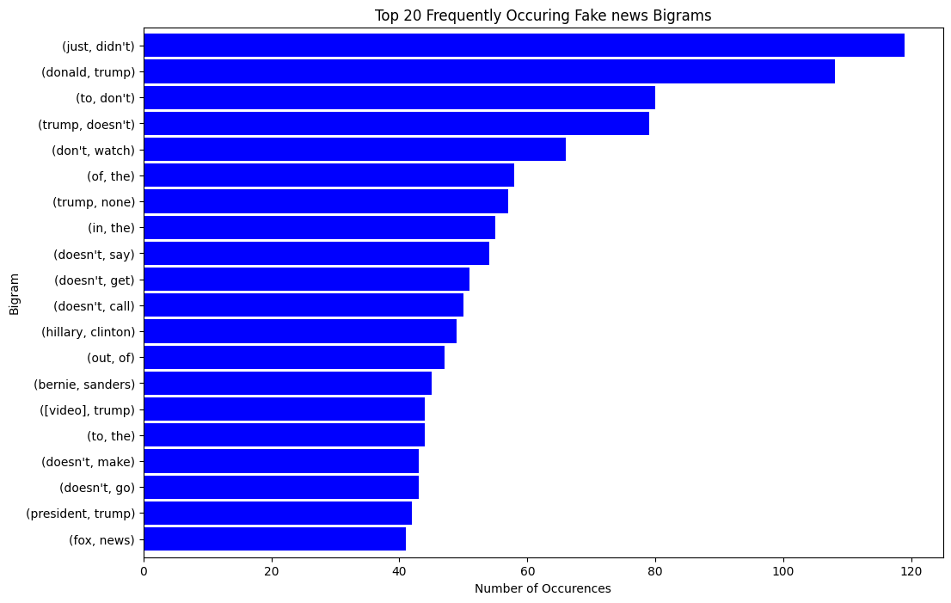
Summary View of Data
Validation Dataset Bigrams vs Negated Validation Dataset Bigrams

Slide 15
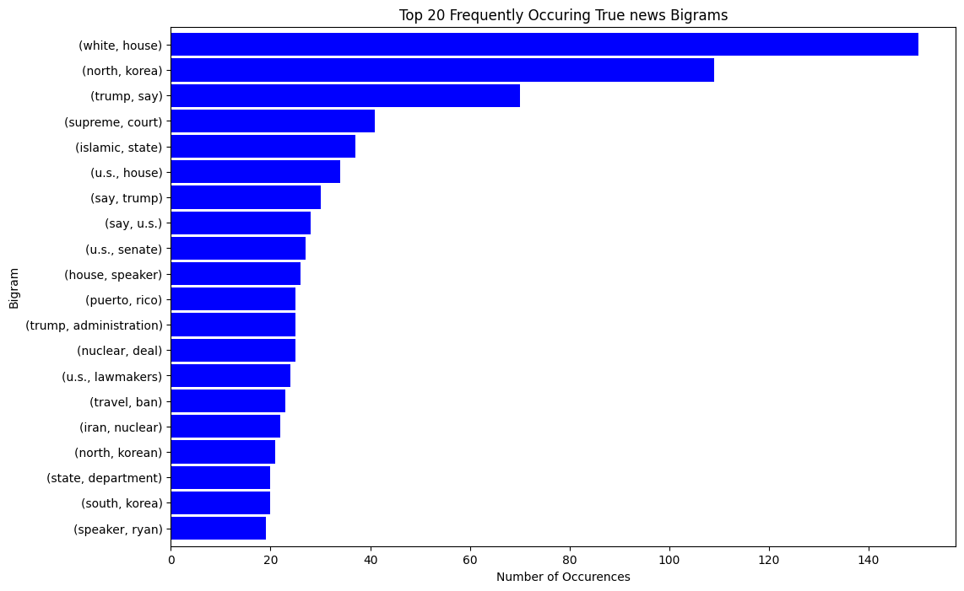
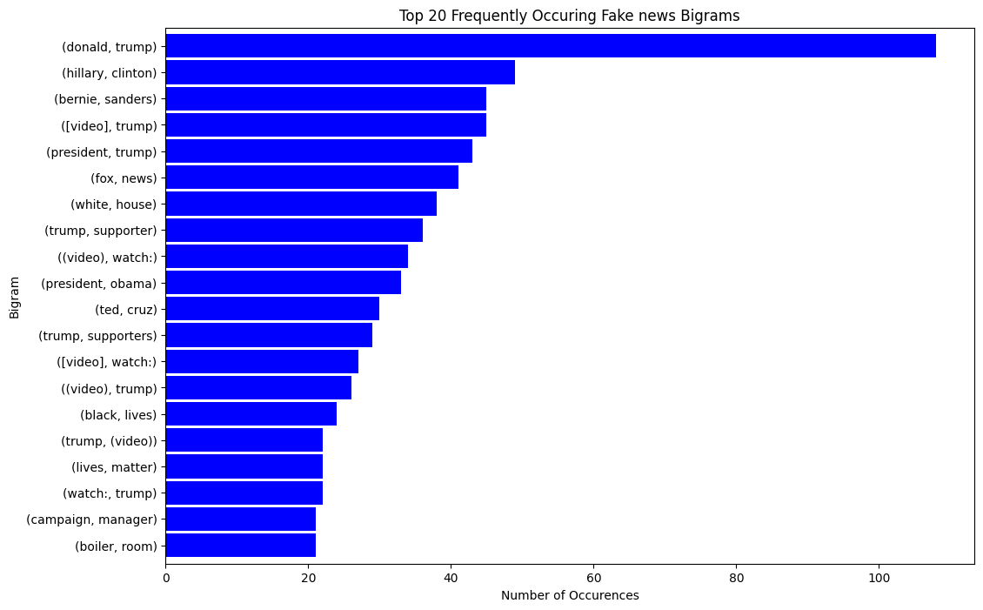

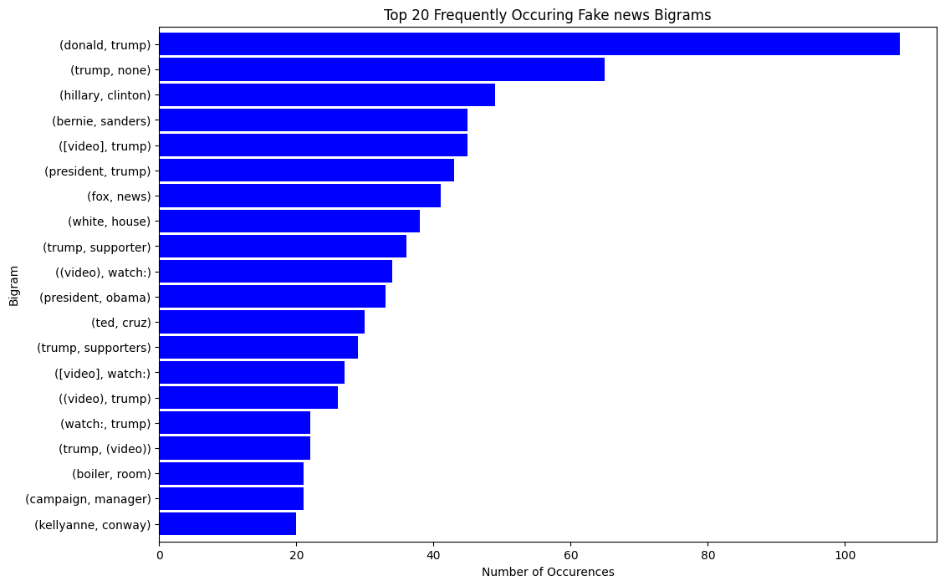
Summary View of Data
Validation Dataset Bigrams no stopwords vs Negated Validation Dataset Bigrams no stopwords

Slide 16
Preprocessing
Removed unused columns
Text
Unnamed Column
Converted to lowercase
Imputed null values
Punctuation removal
Stopwords removal
Using NLTK’s English stop words

Slide 17
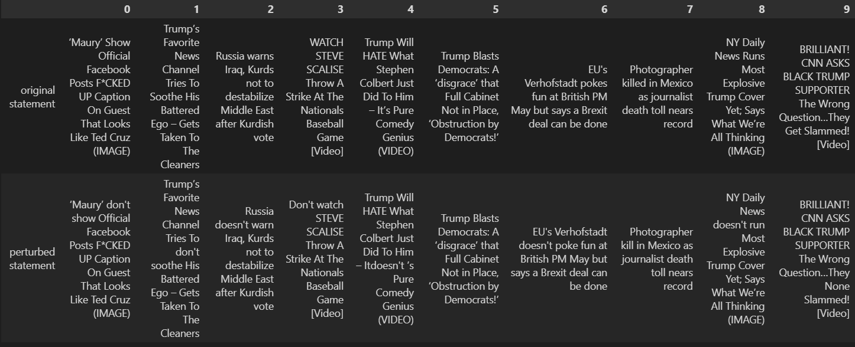
Negation Preprocessing using Negate python module

Slide 18
Feature Extraction
Word2vec Embedding
glove.6B.100d.txt file
Keras Tokenizer - used for loading the text and converting it into a token
Keras Padding – used to equally distribute words in sentences, padding the remaining spaces with zeroes (is used to account for the different size of words)

Slide 19
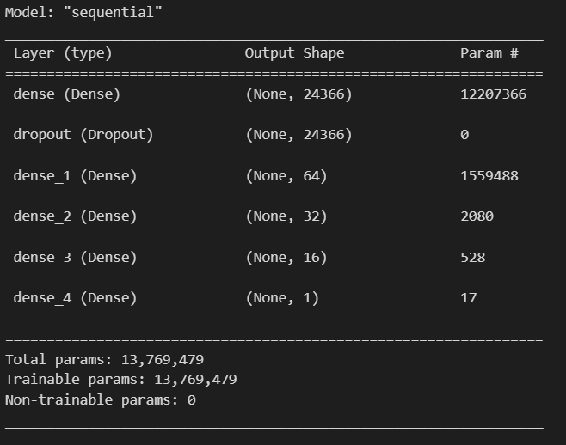
Model Architecture
Dense Layered Sequential Model
Dropout layer set to 0.5 to reduce overfitting
Sigmoid activation function is used because it’s a binary classification problem
Model is trained on Adam optimizer with 1e-4 learning rate
Relu activation is used for 4 of the 5 dense layers
Binary cross entropy loss and accuracy tracked

Slide 20
“All models are bad; some models are useful”

Slide 21
Results
Results are broken down into:
Baseline with and without stopwords
Adversarial Training
Adversarial Attack
Adversarial Training and Adversarial Attack

Slide 22
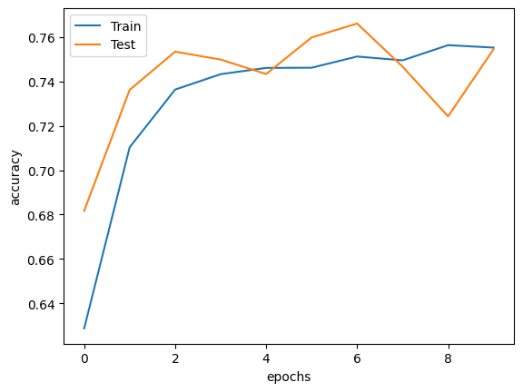
Baseline with Stopwords Results

Slide 23
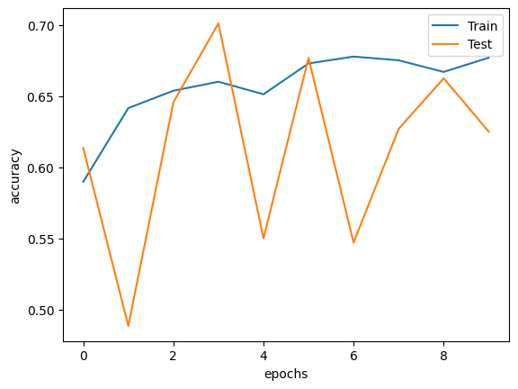
Baseline without Stopwords Results

Slide 24
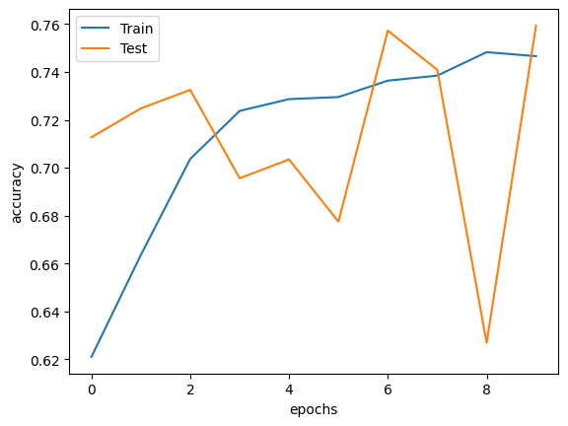
Adversarial Training Results

Slide 25
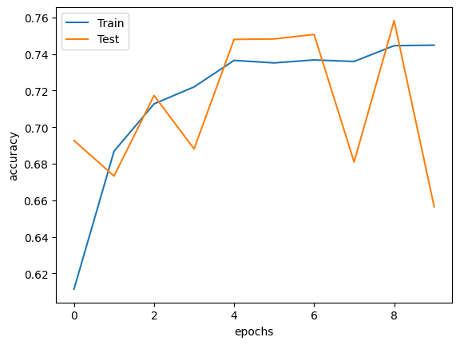
Adversarial Attack Results

Slide 26
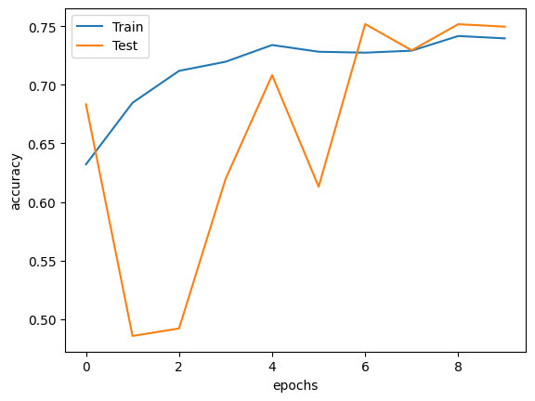
Adversarial Training + Adversarial Attack Results

Slide 27
Discussion
Dataset unreliability?
Wrong model architecture
Removal of stopwords hinders the adversarial example
Model fluctuations
Code improvement
Different word2vec embedding
Better measurements for evaluation
Further research

Slide 28
Conclusion
Did our model achieve our initial hypothesis?
NO
Will I be improving it in the future?
Perhaps
First time dealing with language models
Language models are hard

